Slide 1
Normalisation

Slide 2
LECTURE PLAN
    Purpose of Normalisation
    Redundancy and Data Anomalies
    Repeating Groups
    Functional Dependency
    Transitive Dependency
    Stages of Normalisation

Slide 3
Purpose of Normalisation
To avoid redundancy by storing each ‘fact’ within the database only once.
To put data into a form that conforms to relational principles (e.g., single valued attributes, each relation represents one entity) - no repeating groups.
To put the data into a form that is more able to accurately accommodate change.
To avoid certain updating ‘anomalies’.
To facilitate the enforcement of data constraints.

Slide 4
Redundancy and Data Anomalies
Redundant data is where we have stored the same ‘information’ more than once. i.e., the redundant data could be removed without the loss of information.
Example: We have the following relation that contains staff and department details:
staffNo job dept dname city
SL10 Salesman 10 Sales Stratford
SA51 Manager 20 Accounts Barking
DS40 Clerk 20 Accounts Barking
OS45 Clerk 30 Operations Barking
Such ‘redundancy’ could lead to the following ‘anomalies’
Insert Anomaly: We can’t insert a dept without inserting a member of staff who works in that department
Update Anomaly: We could change the name of the dept that SA51 works in without simultaneously changing the dept that DS40 works in.
Deletion Anomaly: By removing employee SL10 we have removed all information pertaining to the Sales dept.

Slide 5
Repeating Groups
A repeating group is an attribute (or set of attributes) that can have more than one value for a primary key value.
Example: We have the following relation that contains staff and department details and a list of telephone contact numbers for each member of staff.
staffNo job dept dname city contact number
SL10 Salesman 10 Sales Stratford 018111777, 018111888, 079311122
SA51 Manager 20 Accounts Barking 017111777
DS40 Clerk 20 Accounts Barking
OS45 Clerk 30 Operations Barking 079311555
Repeating Groups are not allowed in a relational design, since all attributes have to be ‘atomic’ - i.e., there can be only one value per cell in a table!

Slide 6
Functional Dependency
Formal Definition: Attribute B is functionally dependant upon attribute A (or a collection of attributes) if a value of A determines a single value of attribute B at any one time.
Formal Notation: A → B This should be read as ‘A determines B’ or ‘B is functionally dependant on A’. A is called the determinant and B is called the object of the determinant.
Example:
Functional Dependencies
staffNo job dept dname
SL10 Salesman 10 Sales
SA51 Manager 20 Accounts
DS40 Clerk 20 Accounts
OS45 Clerk 30 Operations
staffNo → job
staffNo → dept
staffNo → dname
dept → dname

Slide 7
Functional Dependency
Compound Determinants: If more than one attribute is necessary to determine another attribute in an entity, then such a determinant is termed a composite determinant.
Full Functional Dependency: Only of relevance with composite determinants. This is the situation when it is necessary to use all the attributes of the composite determinant to identify its object uniquely.
Example:
Full Functional Dependencies
order# line# qty price
A001 001 10 200
A002 001 20 400
A002 002 20 800
A004 001 15 300
(Order#, line#) → qty
(Order#, line#) → price

Slide 8
Functional Dependency
Partial Functional Dependency: This is the situation that exists if it is necessary to only use a subset of the attributes of the composite determinant to identify its object uniquely.
Example:
Full Functional Dependencies
student# unit# room grade
9900100 A01 TH224 2
9900010 A01 TH224 14
9901011 A02 JS075 3
9900001 A01 TH224 16
(student#, unit#) → grade
Partial Functional Dependencies
unit# → room
Repetition of data!

Slide 9
Transitive Dependency
Definition: A transitive dependency exists when there is an intermediate functional dependency.
Formal Notation: If A → B and B → C, then it can be stated that the following transitive dependency exists: A → B → C
Example:
Transitive Dependencies
staffNo job dept dname
SL10 Salesman 10 Sales
SA51 Manager 20 Accounts
DS40 Clerk 20 Accounts
OS45 Clerk 30 Operations
staffNo → dept
dept → dname
staffNo → dept → dname
Repetition of data!

Slide 10
Normalisation - Relational Model
In order to comply with the relational model principles it is necessary to
remove repeating groups and
avoid redundancy and data anomalies by removing full, partial and transitive functional dependencies.
Relational Database Design: All attributes in a table must be atomic, and solely dependant upon the fully primary key of that table.
NORMALISATION
ACHIEVES THIS!
THE KEY, THE WHOLE KEY, AND NOTHING BUT THE KEY!

Slide 11
Stages of Normalisation
Unnormalised
(UNF)
Remove repeating groups
First normal form
(1NF)
Remove partial dependencies
Second normal form
(2NF)
Remove transitive dependencies
Third normal form
(3NF)
Remove remaining functional
dependency anomalies
Boyce-Codd normal
form (BCNF)
Remove multivalued dependencies
Fourth normal form
(4NF)
Remove remaining anomalies
Fifth normal form
(5NF)

Slide 12
Unnormalised Normal Form (UNF)
Definition: A relation is unnormalised when it has not had any normalisation rules applied to it, and it suffers from various anomalies.
This only tends to occur where the relation has been designed using a ‘bottom-up approach’. i.e., the capturing of attributes to a ‘Universal Relation’ from a screen layout, manual report, manual document, etc...

Slide 13
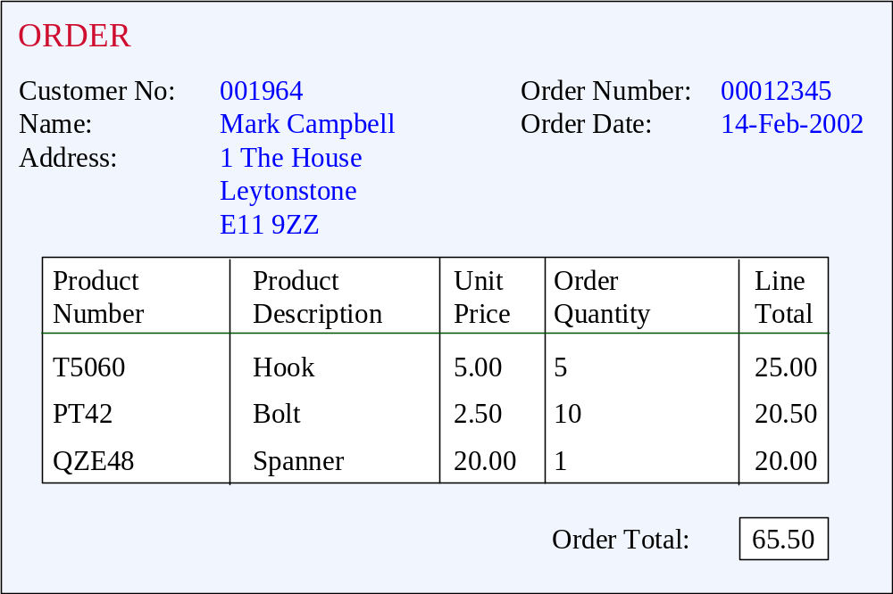
Unnormalised Normal Form (UNF)
ORDER (order-no, order-date, cust-no, cust-name, cust-add,
(prod-no, prod-desc, unit-price, ord-qty, line-total)*, order-total

Slide 14
Rules for the relation R in First Normal Form
Each attribute should contain atomic values
A column (attribute) should contain value from the same domain
No column should have unique name
No ordering of rows and columns
No duplicate rows
DB- Introduction

Slide 15
First Normal Form (1NF)
Definition: A relation is in 1NF if, and only if, all its underlying attributes contain atomic values only.
Remove repeating groups into a new relation
A repeating group is shown by a pair of brackets within the relational schema.
ORDER (order-no, order-date, cust-no, cust-name, cust-add,
(prod-no, prod-desc, unit-price, ord-qty, line-total)*, order-total
Steps from UNF to 1NF:
Remove the outermost repeating group (and any nested repeated groups it may contain) and create a new relation to contain it.
Add to this relation a copy of the PK of the relation immediately enclosing it.
Name the new entity (appending the number 1 to indicate 1NF)
Determine the PK of the new entity
Repeat steps until no more repeating groups.

Slide 16
Example - UNF to 1NF
ORDER (order-no, order-date, cust-no, cust-name, cust-add,
(prod-no, prod-desc, unit-price, ord-qty, line-total)*, order-total
1. Remove the outermost repeating group (and any nested repeated groups it may contain) and create a new relation to contain it. (rename original to indicate 1NF)
ORDER-1 (order-no, order-date, cust-no, cust-name, cust-add, order-total
(prod-no, prod-desc, unit-price, ord-qty, line-total)
2. Add to this relation a copy of the PK of the relation immediately enclosing it.
ORDER-1 (order-no, order-date, cust-no, cust-name, cust-add, order-total
(order-no, prod-no, prod-desc, unit-price, ord-qty, line-total)
3. Name the new entity (appending the number 1 to indicate 1NF)
ORDER-LINE-1 (order-no, prod-no, prod-desc, unit-price, ord-qty, line-total)
4. Determine the PK of the new entity
ORDER-LINE-1 (order-no, prod-no, prod-desc, unit-price, ord-qty, line-total)

Slide 17
Second Normal Form (2NF)
Definition: A relation is in 2NF if, and only if, it is in 1NF and every non-primary-key attribute is fully functionally dependent on the primary key, then the relation is in Second Normal Form (2NF).
Definition: A relation is in 2NF if, and only if, it is in 1NF and every non-key attribute is fully dependent on the primary key.
Remove partial functional dependencies into a new relation
Steps from 1NF to 2NF:
Remove the offending attributes that are only partially functionally dependent on the composite key, and place them in a new relation.
Add to this relation a copy of the attribute(s) which are the determinants of these offending attributes. These will automatically become the primary key of this new relation.
Name the new entity (appending the number 2 to indicate 2NF)
Rename the original entity (ending with a 2 to indicate 2NF)

Slide 18
Rules for the relation R in Second Normal Form
Should be in First Normal form
No partial dependency should exist
Meaning of partial dependency :
  If Proper subset of any candidate key -> (determines) non prime attribute then there exist a partial dependency.
DB- Introduction

Slide 19
Example - 1NF to 2NF
ORDER-LINE-1 (order-no, prod-no, prod-desc, unit-price, ord-qty, line-total)
1. Remove the offending attributes that are only partially functionally dependent on the composite key, and place them in a new relation.
ORDER-LINE-1 (order-no, prod-no, ord-qty, line-total)
(prod-desc, unit-price)
2. Add to this relation a copy of the attribute(s) which determines these offending attributes. These will automatically become the primary key of this new relation..
ORDER-LINE-1 (order-no, prod-no, ord-qty, line-total)
(prod-no, prod-desc, unit-price)
3. Name the new entity (appending the number 2 to indicate 2NF)
PRODUCT-2 (prod-no, prod-desc, unit-price)
4. Rename the original entity (ending with a 2 to indicate 2NF)
ORDER-LINE-2 (order-no, prod-no, ord-qty, line-total)

Slide 20
Third Normal Form (3NF)
Definition: A relation is in 3NF if, and only if, it is in 2NF and every non-primary-key attribute is non transitively dependent on the primary key, then the relation is in Third Normal Form (3NF)
.
Definition: A relation is in 3NF if, and only if, it is in 2NF and every non-key attribute is non-transitively dependent on the primary key.
Remove transitive dependencies into a new relation
Steps from 2NF to 3NF:
Remove the offending attributes that are transitively dependent on non-key attribute(s), and place them in a new relation.
Add to this relation a copy of the attribute(s) which are the determinants of these offending attributes. These will automatically become the primary key of this new relation.
Name the new entity (appending the number 3 to indicate 3NF)
Rename the original entity (ending with a 3 to indicate 3NF)

Slide 21
Example - 2NF to 3NF
ORDER-2 (order-no, order-date, cust-no, cust-name, cust-add, order-total
1. Remove the offending attributes that are transitively dependent on non-key attributes, and place them in a new relation.
ORDER-2 (order-no, order-date, cust-no, order-total
(cust-name, cust-add )
2. Add to this relation a copy of the attribute(s) which determines these offending attributes. These will automatically become the primary key of this new relation..
ORDER-2 (order-no, order-date, cust-no, order-total
(cust-no, cust-name, cust-add )
3. Name the new entity (appending the number 3 to indicate 3NF)
CUSTOMER-3 (cust-no, cust-name, cust-add )
4. Rename the original entity (ending with a 3 to indicate 3NF)
ORDER-3 (order-no, order-date, cust-no, order-total

Slide 22
Example - Relations in 3NF
ORDER-3 (order-no, order-date, cust-no, order-total
CUSTOMER-3 (cust-no, cust-name, cust-add )
PRODUCT-2 (prod-no, prod-desc, unit-price)
ORDER-LINE-2 (order-no, prod-no, ord-qty, line-total)
prod-no
order-no
PRODUCT
ORDER
places
contains
shows
placed by
belongs to
cust-no
order-no, prod-no
CUSTOMER
part of
ORDER-LINE

Slide 23
ANOTHER DEFINITION
A Relation R is said to be in 3NF if and only if it is 2NF and for each of its non-trivial functional dependencies at least one of the following condition holds on the FD
i) L.H.S is the Super Key
ii) R.H.S is Prime Attribute
Note: Trivial means A->B then B C A { contained in}
non-Trivial means B not contained in A
DB- Introduction

Slide 24
Problems in normalization
Given a relation R( A, B, C, D) and Functional Dependency set FD = { AB → CD, B → C }, determine whether the given R is in 2NF? If not convert it into 2 NF.
DB- Introduction

Slide 25
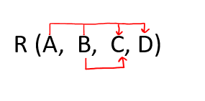
Solution: Let us construct an arrow diagram on R using FD to calculate the candidate key.
From above arrow diagram on R, we can see that an attributes AB is not determined by any of the given FD, hence AB will be the integral part of the Candidate key, i.e. no matter what will be the candidate key, and how many will be the candidate key, but all will have W compulsory attribute.
Let us calculate the closure of AB
AB ⁺ = ABCD
Since the closure of AB contains all the attributes of R, hence AB is Candidate Key
From the definition of Candidate Key(Candidate Key is a Super Key whose no proper subset is a Super key)
DB- Introduction

Slide 26
Since all key will have AB as an integral part, and we have proved that AB is Candidate Key, Therefore, any superset of AB will be Super Key but not Candidate key.
Hence there will be only one candidate key AB
Definition of 2NF: No non-prime attribute should be partially dependent on Candidate Key
If Proper subset of candidate key -> non prime attribute then it is not in 2NF
Since R has 4 attributes: - A, B, C, D, and Candidate Key is AB, Therefore, prime attributes (part of candidate key) are A and B while a non-prime attribute are C and D
a) FD: AB → CD satisfies the definition of 2NF, that non-prime attribute(C and D) are fully dependent on candidate key AB
b) FD: B → C does not satisfy the definition of 2NF, as a non-prime attribute(C) is partially dependent on candidate key AB( i.e. key should not be broken at any cost)
As FD B → C, the above table R( A, B, C, D) is not in 2NF
Convert the table R(A, B, C, D) in 2NF:
Since FD: B → C, our table was not in 2NF, let's decompose the table

Slide 27
R1(B, C)
Since the key is AB, and from FD AB → CD, we can create R2(A, B, C, D) but this will again have a problem of partial dependency B → C, hence R2(A, B, D).
Finally, the decomposed table which is in 2NF
a) R1( B, C)
b) R2(A, B, D)
DB- Introduction

Slide 28
Exercise problem 1
Consider the following relation schema:
CAR_SALE(Car_id, Date_sold, Salesperson_id, Commission_pct, Discount_amt).
Additional functional dependencies are
Date_sold → Discount_amt,
Salesperson_id → Commission_pct.
Based on the given primary key, is this relation in 1NF, 2NF, or 3NF? Why or why not? How would you successively normalize it completely?

Slide 29
CAR_SALE(Car_id, Date_sold, Salesperson_id, Commission_pct, Discount_amt)
Date_sold → Discount_amt,
Salesperson_id → Commission_pct.
R₁(Salesperson_id , Commission_pct.)
R₂ (Car_id, Date_sold, Salesperson_id, Discount_amt)
R₃(Date_sold, Discount_amt)
R₄ (Car_id, Date_sold, Salesperson_id)
D = {R₁, R₃, R₄)

Slide 30
Exercise problem 2
Consider the following relation for published books:
BOOK (Book_title, Author_name, Book_type, List_price, Author_affil, Publisher).
Author_affil refers to the affiliation of author.
Suppose that the following dependencies exist:
Book_title → Publisher, Book_type
Book_type → List_price
Author_name → Author_affil.
What normal form is the relation in? Explain your answer.
Apply normalization until you cannot decompose the relations further. State the reasons behind each decomposition.

Slide 31
BOOK (Book_title, Author_name, Book_type, List_price, Author_affil, Publisher)
Book_title → Publisher, Book_type
Book_type → List_price
Author_name → Author_affil.
R₁(Book_title, Publisher, Book_type)
R₂(Book_title, Author_name, List_price, Author_affil)
R₃(Author_name, Author_affil.)
R₄(Book_title, Author_name, List_price)
D = {R₁, R₃, R₄}
D = {R₁, R₃, R₄, R₅(Book_type, List_price) }

Slide 32
Alternative decomposition
BOOK (Book_title, Author_name, Book_type, List_price, Author_affil, Publisher)
Book_title → Publisher, Book_type
Book_type → List_price
Author_name → Author_affil.
R₁(Book_type, List_price)
R₂(Book_title, Author_name, Book_type, Author_affil, Publisher)
R₃(Author_name, Author_affil.)
R₄(Book_title, Author_name, Book_type, Publisher)
D = {R₁, R₃, R₄}

Slide 33
Exercise problem 3
Consider the universal relation
R = {A, B, C, D, E}
and the set of functional dependencies
F = {AB→C, A→DE}.
What is the key for R? Decompose R into 2NF and then 3NF relations.

Slide 34
Solution
(AB)⁺ = ABCDE = R
A⁺ = ADE ≠ R
B⁺= B
AB is a key of R
AB → C, A → DE
R₁(A, D, E)
R₂(A, B, C)
D = {R₁, R₂}

Slide 35
Exercise problem 4
Consider the universal relation
R = {A, B, C, D, E, G, H, I, J, K}
and the set of functional dependencies
F = {AB→C, A→DE, B→K, K→GH, D → IJ}.
What is the key for R? Decompose R into the
highest possible normal form.

Slide 36
Solution
R(A, B, C, D, E, G, H, I, J, K)
Key of the schema is AB
{AB→C, A→DE, B→K, K→GH, D → IJ}
R₁(D, I, J)
R₂(A, B, C, D, E, G, H, K)
R₃(A, D, E)
R₄(A, B, C, G, H, K)
R₅(K, G, H)
R₆(A, B, C, K)
R₇(B, K)
R₈(A, B, C)
D = {R₁, R₃, R₅, R₇, R₈}

Slide 37
DB- Introduction

